Slide 1
Basic Statistical Concepts
SADET
Module B.2

Slide 2
Probabilistic Thinking
Very few aspects of life are deterministic
E.g., laws of (Newtonian) physics
In contrast, uncertainty accompanies the majority of our every day endeavors
The weatherman said it will rain tomorrow and you take an umbrella with you; you did not have to use it since it didn’t rain
New England Patriots open the season against the Cleveland Browns; Browns win
…

Slide 3
Probabilistic Thinking
Most people are comfortable only with certainty statements
Tomorrow it will rain
Hillary Clinton will win the next Presidential election
…
Unfortunately the most honest expression of future projections must include uncertainty
There is a 78% chance that tomorrow will rain
…

Slide 4
Probabilistic Thinking
Nobel laurates Kahneman and Tversky provided evidence that humans cannot objectively translate probabilities to realistic expectations
We think of a 90% probability the same as a 99% or a 99.999% probability
These are vastly different probabilities!!
Requires time, effort and practice

Slide 5
What is Probability?
In its simplest form the probability of an event E occurring consists of 2 counts
The number of possible outcomes N in the setting under examination
The number of favorable outcomes m for the event E (i.e., which outcomes imply that the event E is realized)
$$\operatorname{Pr}\left[E\right]= \frac{m}{N}$$

Slide 6
Example
Consider throwing a dice twice:
Sample events: let A be the event that the sum is even and let B be the event that we roll at least one 6
P(A) = 18/36=0.5
P(B) = 11/36

Slide 7
Venn Diagrams
Venn diagrams are used to represent the total sample space S (i.e., possible outcomes) as well as the various events
Typically the area that each event covers is proportional to its probability
Sample Space S
Event A
Event B

Slide 8
Venn Diagrams
Venn diagrams are used to represent the total sample space (i.e., possible outcomes) as well as the various events
Sample Space S

Slide 9
Union of Events
For every two events A and B, the probability of their union (either of A or B being happening) is:
Using our previous example:
Avoid double
counting

Slide 10
Conditional Probability
“What is the probability of event A happening, given that we know that event B has already happened?”

Slide 11
Independence
Two events are independent if and only if:
Equivalently:
Intuitively, knowing A doesn’t tell you anything about B and vice-versa
But beware of relying on your intuition: rolling two dice (x_{a} and x_{b}), events x_{a}=2 and x_{a}+x_{b}=k are independent if k=7 and dependent otherwise!
Notes:
Use the definition and calculate the corresponding probabilities. For k=7, P(x_a=2) = 1/6, P(x_a+x_b=7) = 1/6, P(A and B) = 1/36. For the other values of k, all remain the same but P(x_a+x_b = k) ~= 1/6

Slide 12
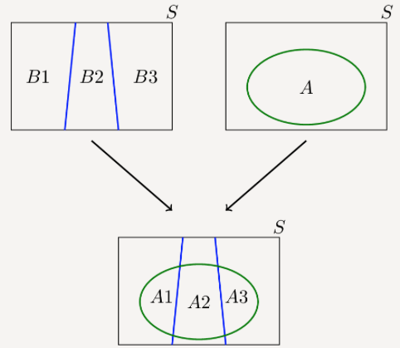

Law of Total Probability
If $ℬ$ is a partition of the sample space S, i.e., a set of pairwise disjoint events whose union is the entire sample space, then the probability of event A can be expressed as: $P\left(A\right)=\sum_{i}{P\left(A∩B_{i}\right)=}\sum_{i}{P\left(A|B_{i}\right)⋅P(B_{i})}$
Image source: https://www.probabilitycourse.com/chapter1/1_4_2_total_probability.php

Slide 13
Bayes’ Rule
The single most important rule in probability
Often used to update beliefs
Successful gamblers rely on this rule!
posterior = “support B provides for A” x “prior”

Slide 14
Prior belief
New data
Posterior belief

Slide 15
Example
If an athlete has taken performance enhancing drugs (PEDs), there is a 90% chance that his/her test results are positive. However the test results are not very correct; there is a chance for 1% false positive. Also only 1% of the total athletes population users PEDs. Now one athlete’s test result came out as Positive. What’s the odds that he has actually used PEDs?
U: event that person has malaria
T: event that test is positive
P(T|U) = 0.9
P(T|~U) = 0.01
P(U) = 0.01
$$P\left(U | T\right)=\frac{P\left(T | U\right)P(U)}{P(T)}$$
Law of total
probability
$$P\left(T\right)=P\left(T | U\right)P\left(U\right)+P\left(T | \sim U\right)P(\sim U)$$
Substituting we finally get P(U|T)=0.476

Slide 16
The Prior
Critiques take issue with the notion of the Bayesian prior
Too subjective
Decide how likely is something to happen before we experiment for it
However, Bayesian approach puts data in context
It also explicitly states that people will always have their subjective opinions/biases
This does not mean that the Bayesian approach is biased!
On the contrary, it gives us the tools to reduce these biases as we collect more evidence

Slide 17
The Prior
Once enough evidence have been collected, the Bayesian approach will reach an objective estimation of the probability irrespective of the prior chosen
Prior can be chosen using historical data
Given the application a specific choice for prior might be logical
Uninformative prior

Slide 18
Posterior belief
after evidence N
Posterior belief
after evidence 1
Prior belief
True probability
…
0
Posterior belief
after evidence 2
1
A better chosen prior would have approached the true probability “faster”, i.e., after a smaller number of observations.

Slide 19
Random Variables
A variable that does not take a single – deterministic - value but it can take a set of different values, each with an associated probability
Discrete & Continuous
E.g., let X be the random variable (r.v.) that counts the number of 6s that we roll when we throw two dices
P(X=2)=P({6,6}) = 1/36
P(X=1)=P({1,6})+P({2,6})+P({3,6})+…+P({5,6})+P({6,1})+…=10/36
P(X=0)=?

Slide 20
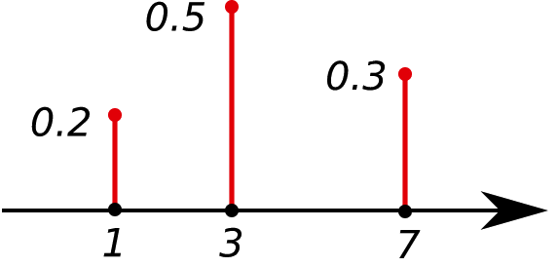
Distributions of Random Variables
A probability mass function (pmf) assigns a probability to each possible value of a discrete random variable
Funny “dice”
Source: Math Stack Exchange

Slide 21
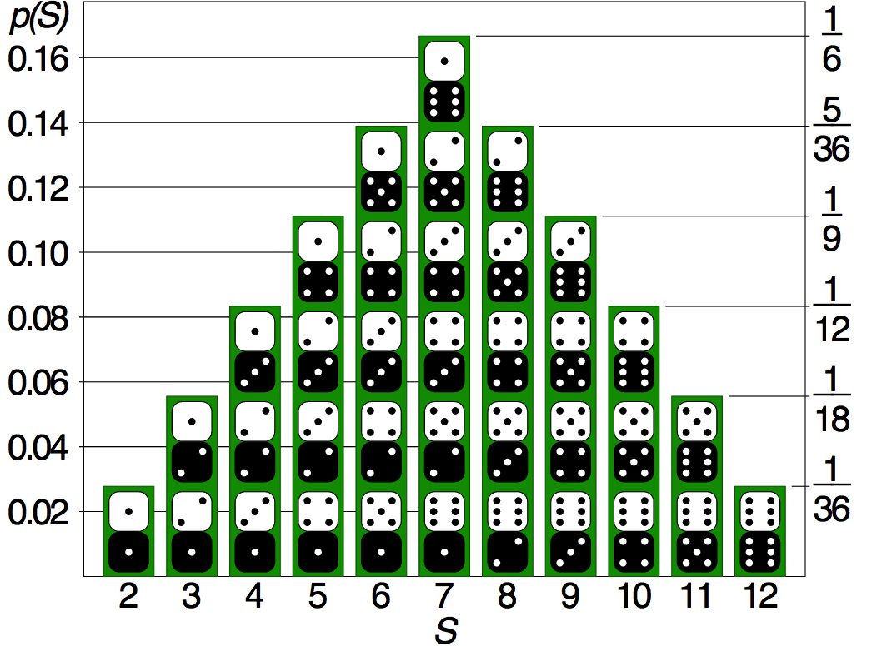
Distributions of Random Variables
Distribution over the sum of two
dice rolls
Source: Math Stack Exchange

Slide 22
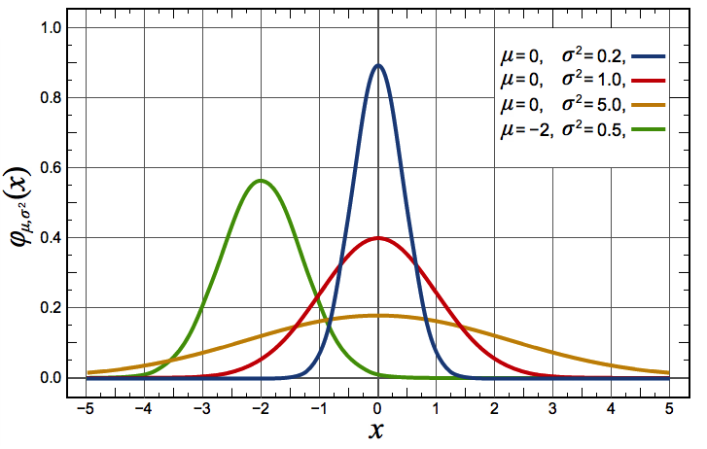
Distribution of Random Variables
A continuous random variable X is described through the probability density function (pdf)
PDF describes the relative likelihood for X to take a given value
What is the probability that X = b?
Source: wikipedia

Slide 23
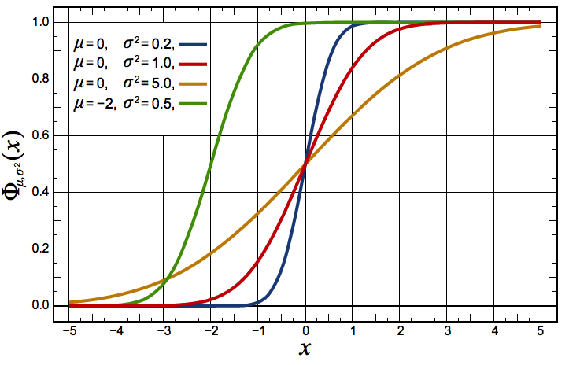
Distribution of Random Variables
The cumulative distribution function (CDF) of a continuous random variable X is:
Source: Wikipedia

Slide 24
Properties of r.v. Distributions
CDF
PMF
PDF

Slide 25
Expectations and Variance
If the discrete random variable X has pmf p(x), then the expected value of X is:
For a continuous r.v. we have a similar result:
Expectation is linear:
Variance is not linear:

Slide 26
The Normal Random Variable
Many quantities are known (or assumed) to follow a normal random variable
A person’s IQ, a player’s batting average, a person’s height etc.
This allows us to determine how unusual an observation is
E.g., which is more unusual: a major league batter who hits .360 or a person with IQ 140?
Source: Wikipedia
Source: Wikipedia

Slide 27
The Standard Normal Random Variable
Source: Quora
z-scores have an average of 0 and standard deviation of 1
A z-score of ±2 indicates that an observation more extreme than our data point has roughly a 5% chance of occurring
$$z−score=\frac{x−μ}{σ}$$

Slide 28
The Standard Normal Random Variable
Quiz
Stock market return: μ=0%, σ=1.5%
Height of American male: μ=69in, σ=4in
What is more unusual: (a) a 22% drop in the stock market in a day or (b) seeing a 30-inch-tall male walk down the street
$$z_{a}=\frac{−22−0}{1.5}=−14.67, z_{b}=\frac{30−69}{4}=−9.75$$

Slide 29
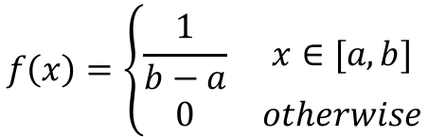
Uniform Random Variable
This distribution describes a variable that takes equally probably values within a range:
$$f\left(x\right)=\left\{\begin{matrix}\frac{1}{b−a} & x∈[a,b] \\ 0 & otherwise\end{matrix}\right.$$
Source: wikipedia

Slide 30

Exponential distribution
An exponential distribution describes the time between two events that follow the Poisson process:
Events occur continually and independently of each other
Events occur at a constant average rate
For example, the time between the goals scored by a soccer
team, or the time between two calls received in a call center
$f\left(x\right)=λe^{−λx}$, $x≥0$
Average rate of the process’ events
Source: wikipedia

Slide 31

Poisson distribution
This describes a discrete random variable that represents the number of events of a Poisson process occurring within a fixed interval of time
For instance, the number of goals scored by the home team in a hockey game, the number of calls received by a phone call center during a day etc.
$$\operatorname{Pr}\left(k\right)=e^{−λ}\frac{λ^{k}}{k!}$$
Average rate of the process’ events
Source: wikipedia

Slide 32
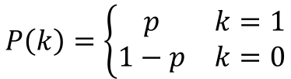
Bernoulli distribution
Bernoulli distribution describes the outcome of a binary experiment (yes/no) also called Bernoulli trial
Coin flip
Free throw shot
Assuming k=1 for “yes” and k=0 for “no” we have:
$$P\left(k\right)=\left\{\begin{matrix}p & k=1 \\ 1−p & k=0\end{matrix}\right.$$

Slide 33
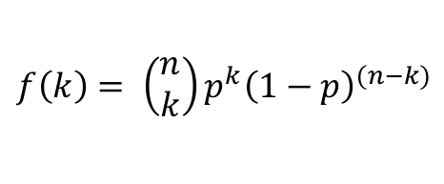
Binomial distribution
The binomial distribution describes the number of successful Bernoulli trials in a series of n independent trials
Number of heads in a series of 100 coin flips
Number of free throws made in a series of 100 free throw shots
$$f\left(k\right)= \left(\begin{matrix}n \\ k\end{matrix}\right)p^{k}{\left(1−p\right)}^{(n−k)}$$
Number of possible ways to choose k items from a set of n items
Probability of success of each Bernoulli trial
Source: wikipedia

Slide 34
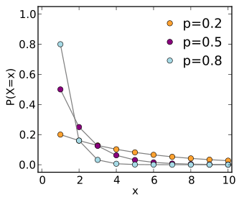

Geometric distribution
The geometric distribution describes the number of independent Bernoulli trials needed to get one success
The number of kidney donors passed until one with matching kidney is found
The number of kids a family has before they have a boy
$$\operatorname{Pr}\left(k\right)={\left(1−p\right)}^{k−1}p$$
Probability of success of each Bernoulli trial

Slide 35
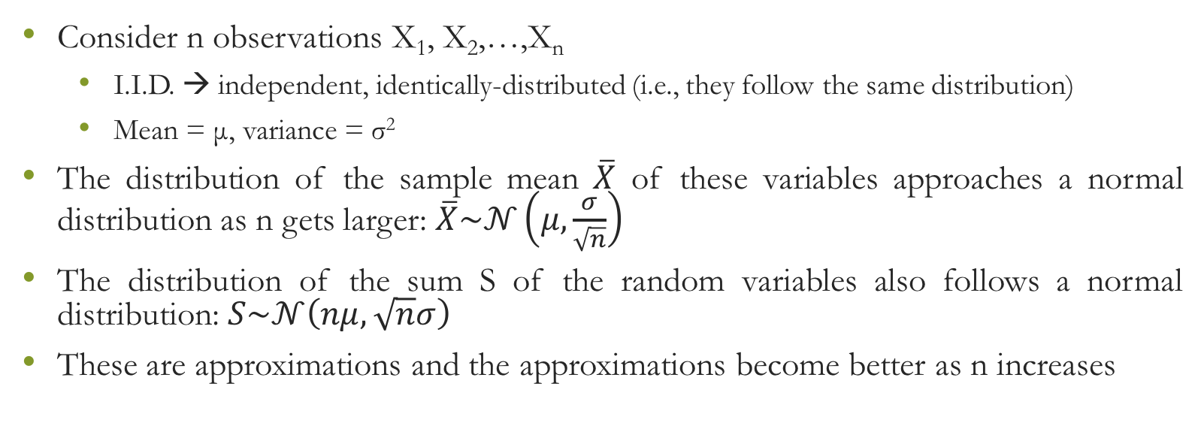
Central Limit Theorem
Consider n observations X₁, X₂,…,X_{n}
I.I.D. → independent, identically-distributed (i.e., they follow the same distribution)
Mean = μ, variance = σ²
The distribution of the sample mean $\overline{X}$ of these variables approaches a normal distribution as n gets larger: $\overline{X}\sim 𝒩\left(μ,\frac{σ}{\sqrt{n}}\right)$
The distribution of the sum S of the random variables also follows a normal distribution: $S\sim 𝒩\left(nμ,\sqrt{n}σ\right)$
These are approximations and the approximations become better as n increases

Slide 36
Central Limit Theorem
The number of tickets purchased by a student standing in line at the ticket window for the football match of Pitt against Penn State follows a distribution with mean equal to μ = 2.4 and standard deviation σ = 2.0.
Few hours before the game there are 100 students already waiting in line
There are only 250 tickets left
What is the probability that all 100 students will be able to purchase the tickets they desire?

Slide 37
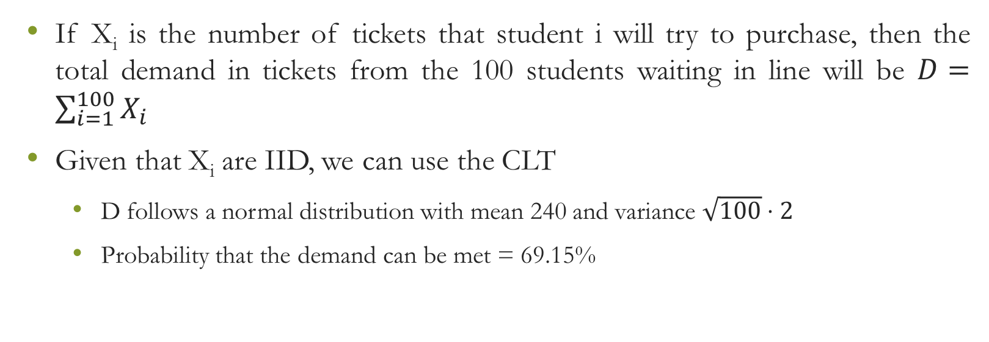
Central Limit Theorem
If X_{i} is the number of tickets that student i will try to purchase, then the total demand in tickets from the 100 students waiting in line will be $D=\sum_{i=1}^{100}{X_{i}}$
Given that X_{i} are IID, we can use the CLT
D follows a normal distribution with mean 240 and variance $\sqrt{100}⋅2$
Probability that the demand can be met = 69.15%

Slide 39
Bayes Theorem for Distributions*
We have seen earlier the version of Bayes theorem that deals with point estimate probabilities
It is not always possible to estimate a single value for a probability
There is a version of the theorem that deals with probability distributions:
$$π\left(θ | data\right)=\frac{f(data|θ)}{f(data)}⋅π(θ)$$
Prior probability distribution
for the quantity of interest θ
Posterior probability distribution for the quantity
of interest θ after observing new evidence
Likelihood of observing the data given θ
Total probability of observing the data

Slide 40
Bayesian player evaluation*
Your team has brought in practice a kicker for evaluation
The special teams coach has him attempt 20 50-yard FGs
He makes 16 of them
What is his true success rate σ on 50-yard FGs ?
He is an 80% kicker on 50-yard FGs, right?
NO

Slide 41
Bayesian player evaluation*
Before having the kicker shot any FGs we have a prior belief on his ability
This is the success rate of the NFL kickers collectively on 50-yard FGs
The average success rate is ~70%
Some kickers are exceptional (e.g., Tucker) and above average
Some kickers are bad in long FGs
Most of them are about average
Beta distribution

Slide 42
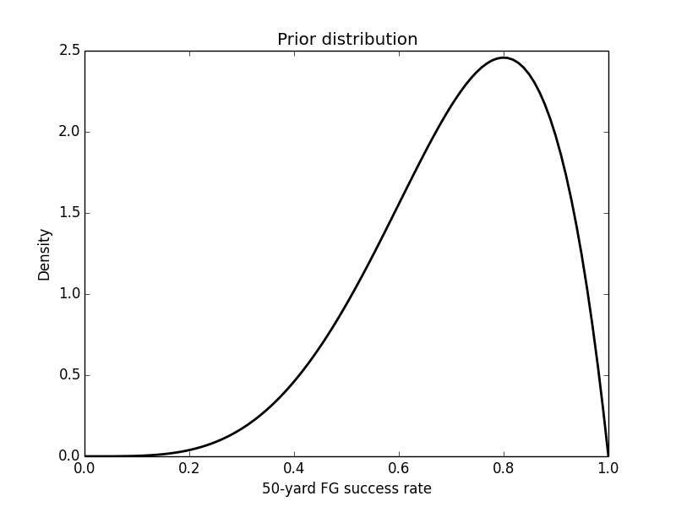
Bayesian player evaluation*
$$f_{Beta}\left(σ;α,β\right)=\frac{1}{B\left(α,β\right)}σ^{α−1}{\left(1−σ\right)}^{β−1},$$
$$B\left(α,β\right)=\frac{\left(α−1\right)!\left(β−1\right)!}{\left(α+β−1\right)!} , 0≤σ≤1$$
α=5, β=2

Slide 43
Bayesian player evaluation*
Next we need to calculate the likelihood of observing the data we have observed given the success rate σ
The likelihood function for our example is simply a binomial with a success probability σ:
Finally, the total probability is:
$$f\left("16−of−20" | σ\right)=\left(\begin{matrix}20 \\ 16\end{matrix}\right)σ^{16}(1−σ)^{4}$$
$$f\left("16−of−20"\right)=\int_{0}^{1}{{\left(\begin{matrix}20 \\ 16\end{matrix}\right)σ}^{16}(1−σ)^{4}\frac{1}{B\left(α,β\right)}σ^{α−1}{\left(1−σ\right)}^{β−1}dσ}$$

Slide 44
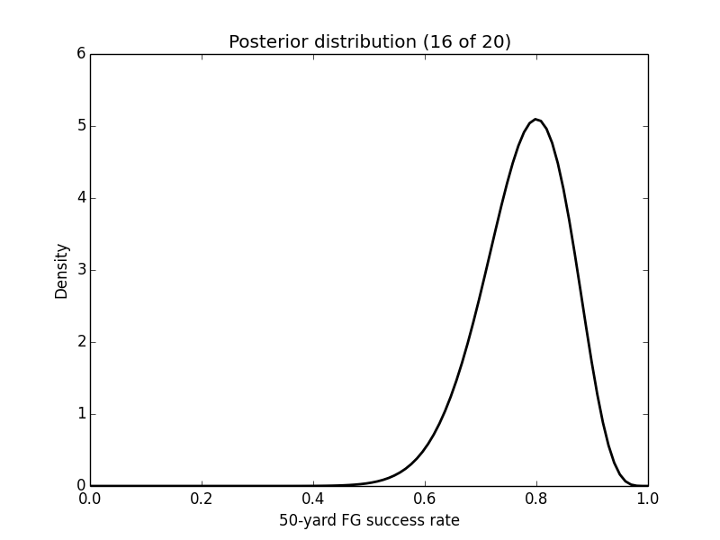
Bayesian player evaluation*
The posterior distribution is still a Beta distribution (with different parameters)
Using this posterior distribution the probability that the kicker is an 80% success rate or better at 50-yard FGs is:
$\operatorname{Pr}\left[kicker σ≥80\%\right]=\int_{0.8}^{1}{π\left(σ | \text{"16}\text{−}\text{of}\text{−}\text{20"}\right)dσ}$ = 0.42

Slide 45
Conjugate priors*
When the posterior and the prior distributions belong to the same family they are called conjugate distributions
The prior is called conjugate prior for the likelihood function
Depending on the process that we describe the choice of likelihood function might be straightforward
E.g., for the example earlier, the success of a FG (trial) can be described Bernoulli distribution

Slide 46
Likelihood | Prior
Bernoulli | Beta
Poisson | Gamma
Multinomial | Dirichlet
Normal | Normal
Uniform | Pareto
Exponential | Gamma

Slide 47
Bayesian Average
Sometimes we have to compare averages that were obtained with different number of observations
How reliable is a 5 rating rating for a movie that only 1 review?
We can adjust the averages using a similar approach with the Bayes rule
Average # of ratings for all movies
$$\tilde{μ_{i}}=\frac{\overline{N}⋅μ+ N_{i}{⋅μ}_{i}}{\overline{N}+N_{i}}$$
# of possessions for movie i
Average rating over all movies
“Raw” rating for movie i

Slide 48
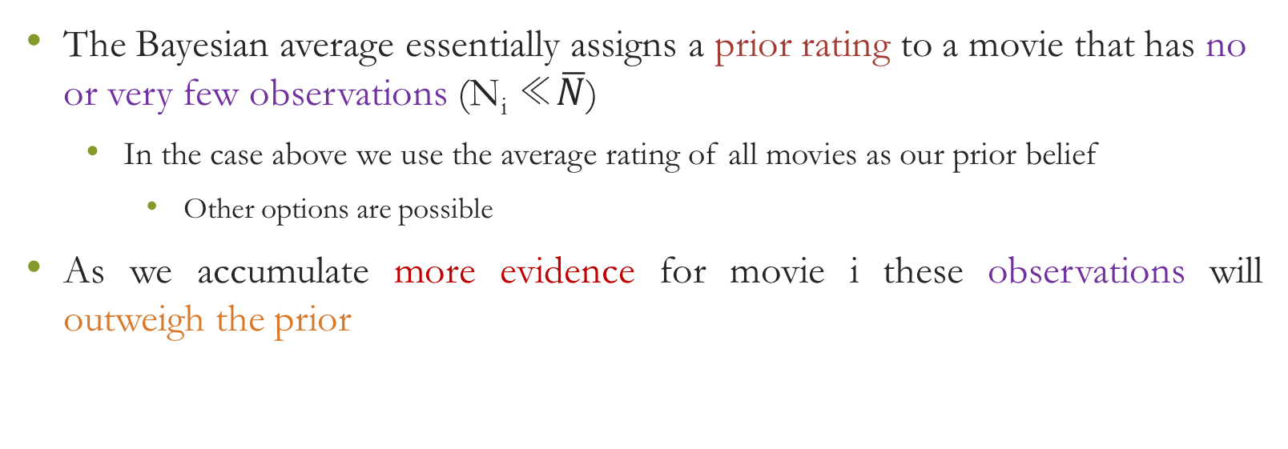
Bayesian Average
The Bayesian average essentially assigns a prior rating to a movie that has no or very few observations (N_{i} ≪$\overline{N}$)
In the case above we use the average rating of all movies as our prior belief
Other options are possible
As we accumulate more evidence for movie i these observations will outweigh the prior

Slide 49
Bayesian Average
There is a new camera X on Amazon with a 4.5 average rating
There is only 10 rating for this camera
All other camera’s on Amazon have an average rating of 3.9 over an average of 56 ratings
The Bayesian adjusted rating for camera X is: 3.99 (strong weight to the prior)
If the raw rating for X was 4.5 with 100 reviews, the Bayesian adjustment would be 4.3 (the importance of the prior is reduced)

Slide 50

A note on average and median values
Always remember that average is highly susceptible to outliers and you can obtain a distorted view of results
Median is more robust
If Jeff Bezos walks into our classroom the average wealth of the class most probably will skyrocket. However, the median will stay practically the same

Slide 51
Hypothesis Testing
Hypothesis testing aims at determining whether there is enough statistical evidence to support a certain hypothesis
Best everyday life example: criminal trials
In a criminal trial we have a (null) hypothesis as a starting point, that is, that the defendant is not guilty (innocent)
The prosecution tries to collect and present evidence that can reject the null hypothesis beyond a reasonable doubt, that is:
The probability of observing these evidence under the innocence hypothesis is extremely small

Slide 52
Hypothesis Testing
You need to set up two competing hypotheses, that is, a null and an alternative hypothesis
Default is to accept the null unless there is overwhelming evidence against it
What is overwhelming?
Most statisticians believe that if the data indicate (under the assumption that the null hypothesis is true) that the probability of observing a value as extreme as the one we have is less than 5% then we should reject the null hypothesis

Slide 53
Hypothesis Testing
In principle one has to calculate the probability of obtaining an observation as extreme as the one observed under the assumption that the null hypothesis is true
If this probability is “small” then we can reject the truthfulness of the null hypothesis
Simply put, it is highly unlikely that we got this extreme observation by chance
The notion of small is subjective and this is one of the reasons that hypothesis testing can be abused
Randomization is an empirical way to do a hypothesis testing

Slide 54

Hypothesis Testing
Let us assume that we want to compare the daily number of customers in two near by coffee shops
We have observed daily numbers of customers for a 3-month period
Can any observed difference be attributed to chance?
We can empirically randomly shuffle the observations
across the two cafes
We pre-process the samples to make the null true
Subtract the sample mean from each data point
$$\begin{matrix}H_{0}: & C_{1}=C_{2} \\ H_{1}: & C_{1}≠C_{2}\end{matrix}$$
Source: Can Stock Photo
Source: Go Graph

Slide 55
Hypothesis Testing

Slide 56
Hypothesis Testing
Sometimes hypothesis testing can be easier if we can find a closed form expression for the statistic of interest
If a random variable follows a normal distribution, then its z-score has a 5% chance to exceed 2 (1.96 to be more precise) in absolute value
If we define a test statistic based on our data that follows a normal distribution, then there is only a 5% chance that the z-score of the test statistic will exceed 2 in absolute value
Thus, if the absolute value of the test statistic exceeds 2 we should reject the null hypothesis

Slide 57
Error Types
Given that we reject the null hypothesis under some probabilistic arguments, it is still possible that we reject the null but still the null is true
After all there is still a small – but non-zero – probability of the observation having obtained by pure chance
False positive (Type I error)
Similarly, we might fail to reject the null but in reality the null is false
False negative (Type II error)

Slide 58


Error Types
Type I and II errors are like communicating vessels
You cannot reduce both at the same time
Type I
Type II
Type I
Type II

Slide 59
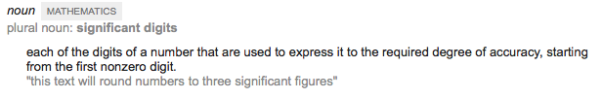
Significance – vs - Resolution
Many times the notion of significance is confused with that of resolution
A number with 10 significant digits does not add to the significance of the number
However, people might thinks that 1.245223 is more significant than 1.2
Significance is related with the notion that the real value of the number is with high probability within a range of interest – typically not including the value of 0 – depending on the application

Slide 60
Significance – vs - Importance
Statistical significance does not equal importance
A number (an effect) might be statistically significant - i.e., non-zero – but this does not mean it is important for the application examined
You might find that the new design of your website increased the new daily visitors by 0.05 viewers a day and this number is statistically significant
Is it important? This is about 20 new visitors in a year!!
This problem is pronounced with the advent of big data that many times lead to being able to identify significant but unimportant/small effects

