Slide 1
Embedding Information Security into the Organization
Johnson, M.E.; Goetz, E.
IEEE Security and Privacy Magazine
Emily Ecoff
February 26, 2008

Slide 2
New Information Security Risks
Terrorist groups
Foreign governments & espionage
Professional cybercrime operations
Outsourcing & off-shoring
Mobile workers, telecommuters, & contractors

Slide 3
CISO Challenges
Raising the level of understanding within an organization
  Goal: organization members know what questions to ask and how to find the services they need.
    Education must start at the top
    Middle management is the largest challenge
    Raise Awareness
      Personalize risks for managers by showing them how vulnerabilities could affect them as individuals.
    Senior Leadership should hold middle management accountable
Notes:
Managing security risks is a balancing act between maintaining security and not inhibiting the business
Middle management is the largest challenge because they impact the organization daily

Slide 4
CISO Challenges
Challenging Behavior
  Goal: To move from reactive stance on security to a proactive stance.
    Deal more effectively with emerging problems and compliance
    Line managers take personal responsibility for security
    Use auditors to help enforce security levels
Dealing with Globalization
  Goal: Get security into key critical applications that run the business outside the infrastructure.
Notes:
A proactive stance will help organizations deal more effectively with emerging problems and compliance issues

Slide 5
CISO Challenges
Protecting Data and Intellectual Property
  Goal: To have strong identity management control who controls access to information and with what permissions
Moving from Technology to Security Management
  Goal: Security groups to provide governance, policy development, and consultancy-type functions to help match operational security risks with business objectives
    Not just security technologies and solutions
    Security as a critical business function
    Security groups should have greater authority to enforce measures
Notes:
Are the things that you think you just said ‘no’ on actually enforceable? Or are people going to do it anyway?
Give security groups veto power over decisions associated with excessive risk, even if this means pushing back a new product or launch date

Slide 6
CISO Challenges
Expanding Securely
  Goal: As the size and scope of operations grow, maintain a consistently high level of security
Complying with laws and standards
Funding Improvement with tight budgets
Notes:
Companies often make business decisions about expansion w/o first consulting the security group concerning possible risks
Stay in compliance with various gov’t laws and regulations… HIPAA, PCI-DSS
Budget cuts – having to do more with less, limited resources – abundance of threats

Slide 7
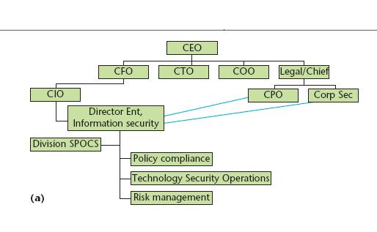
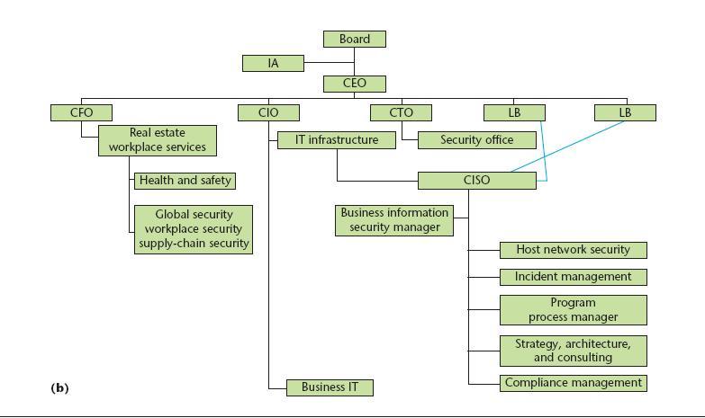
Organizing Security
In 85% of the studied firms, the top security executives report to the CIO
Figure a shows an organizational structure in which security management reports directly to the CIO.
Figure b shows an organizational structure in which security management reports indirectly to the CIO through other IT executives.
Notes:
Some security organizations also liaise with other company departments such as HR, legal, risk-management, physical security, etc.
CIO usually controls and approves funding
However, sometimes several different sources might control funding (operational security)

Slide 8
Organizing Security II
Change is good
  Security group’s organizational structure undergo frequent change
  Restructuring security functions is an ongoing process
    Changes are due to company’s operational environment, business goals, new regulations, and external-risk environment
Security beyond firm boundaries
  Add security clauses to supplier contracts
  Allow the organization to periodically test the partner’s security
Notes:
Security baselines, adherence to security standards, best practices
Enforcing remediation of security vulnerabilities is difficult – need support of business unit that plans to work with the partner

Slide 9
Security is about people
More important than the structuring of a security organization is the people that implement security successfully
Need people that have technical and engineering skills
  “I would throw out any of the best and brightest technicians that I met for one person that could tell me about a manufacturing line. We don’t have any middle ground with people understanding the business. I’m talking about security people. I don’t think security people understand business.”
                Bose’s Terri Curran
Goals:
  Prevent burnout
  Manage a healthy rate of turnover
  “Keep awake and alive and passionate about what is fundamentally feeling like a losing battle.”
Notes:
Need people that take ownership of security and build good relationships
Need people who understand how to explain risk-reward trade-off and can sell solutions within the organization

Slide 10
Transforming the Organization
Find ways to effectively measure security and quantify if security is improving
  Checklists or scorecards to track security
  Composite metrics to provide insight into security levels
  Measure immunity and resiliency
  Benchmarking and Certification
Create an organizational culture of security that ensures that security is present and part of every employee’s understanding of risk
  Executives and senior-level management need to set tone
  Reward people when they are practicing a safe computing environment
  Also must have consequences, and advertise both
  Focused education and ongoing discussion
Notes:
Scorecards measure things like IT operations, system architectures, security measures, and compliance. Used to check if certain measures have been implemented, how many vulnerabilities exist in certain systems, how many attacks an organization is facing.
A problem with scorecards – is they often provide some kind of percentage score, but its hard to really prove their vailidity
Composite metrics aim to provide risk scores so that different groups within the organization can set security targets and help identify acceptable risk levels
(security training & testing scores, audit findings, actual security breaches and events, and individuals security behavior)
(BOA)
Immunity metric: percentage of data destroyed compared to the total population data; numberof monitoring violations; number of rogue devices or managed devices on the network
Resiliency metric: how quickly the security team stopped the spread of a virus, or whether there was business downtime due to a DoS attack
ISO 17799 is a basic level of assurance – shows that an organization implemented some security measures and checks – doesn’t always help reduce risk or improve security, but helps with compliance
Top level management need to be aware of, engaged in, and supportive of security issues, - then can make informed decisions
Middle management might represent the biggest barrier to transforming the organization

Slide 11
Investment Decisions
Develop security investment models that build security in every part of the project.
  Shouldn’t just be about compliance
  Build security in from the beginning
  Demonstrate that security is an “enabler” because it saves money by preventing negative things from happening
  Move from reactive add-ons to proactive initiatives that are aligned with the company’s strategic goals
Notes:
Security executives believe that compliance may do more harm than good because people adopt an “if we’re compliant, we must be secure” attitude
Building security in from the beginning is cheaper and saves time, compared with having to bolt it on later

