Slide 1
IS 2620: Developing Secure Systems
IS 2620
Secure Software Development Models/Methods
Lecture 1
Jan 8, 2013
James Joshi,
Associate Professor

Slide 2
Objective
Understand/Familiarize with various process models for secure software development and assurance
  Capability Maturity Models
    CMMI, iCMM, SSE-CMM
    TSP
  Secure software development life cycle models

Slide 3
Process Models
Secure Process
  Set of activities performed to develop, maintain, and deliver a secure software solution
  Activities could be concurrent or iterative
Process model
  provides a reference set of best practices that can be used for both
    process improvement and process assessment.
  defines the characteristics of processes
  usually has an architecture or a structure

Slide 4
Process Models
Process Models
  Identify technical and management practices
    good software engineering practices to manage and build software
  Establishes
    common measures of organizational processes throughout the software development lifecycle (SDLC).
  But … no guarantees product is bug free

Slide 5
Process Models
Typically also have a capability or maturity dimension used for
  assessment and
  evaluation purposes.
Assessments, evaluations, appraisals includes
  comparison of a process being practiced to a reference process model or standard
  understanding process capability in order to improve processes
  determining if the processes being practiced are
    adequately specified, designed, and implemented

Slide 6
Software Development Life Cycle (SDLC)
A survey of existing processes, process models, and standards seems to identify the following four SDLC focus areas for secure software development
  Security Engineering Activities
  Security Assurance
  Security Organizational and Project Management Activities
  Security Risk Identification and Management Activities

Slide 7
SDLC
Security Engineering Activities
  activities needed to engineer a secure solution.
    security requirements elicitation and definition,
    secure design based on design principles for security,
    use of static analysis tools,
    reviews and inspections, security testing, etc..
Security Assurance Activities
  verification, validation, expert review,
  artifact review, and evaluations.

Slide 8
SDLC
Security Organizational and Project Management Activities
  Organizational management
    organizational policies, senior management sponsorship and oversight, establishing organizational roles, ….
  Project management
    project planning and tracking,
    resource allocation and usage
Security Risk Identification and Management Activities
  Cost-based Risk analysis
  Risk mitigation ..

Slide 9
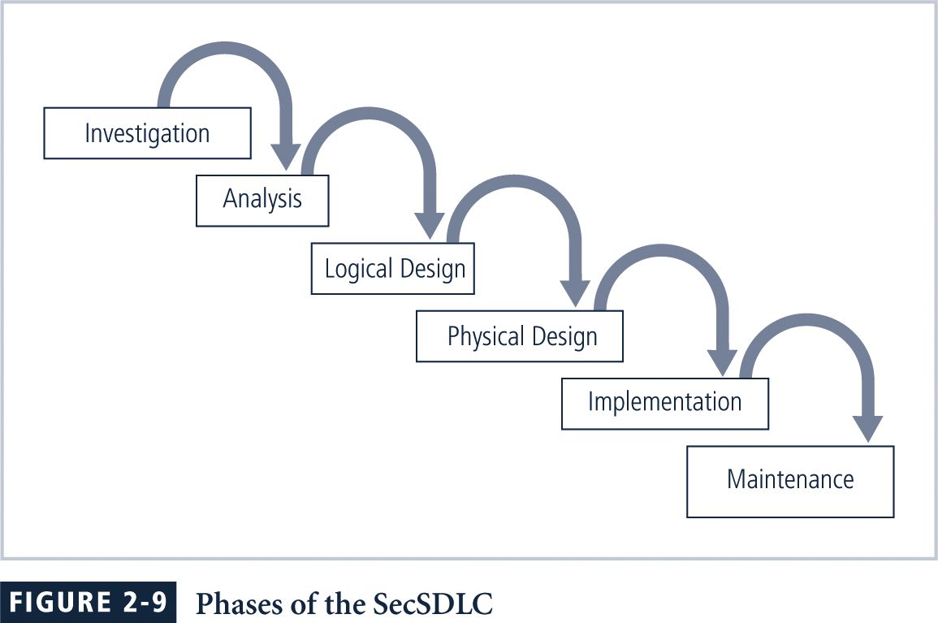
System DLC

Slide 10
Capability Maturity Models (CMM)
CMM
  Provides reference model of mature practices
  Helps identify the potential areas of improvement
  Provides goal-level definition for and key attributes for specific processes
  No operational guidance !!
  Focuses on/Defines process characteristics
Notes:
Not same as Product evaluation or System certification (not to replace them)
Focus on: Better schedule mgmt; better quality mgmt and reduction of defect rate.

Slide 11
CMM
Three CMMs
  Capability Maturity Model Integration® (CMMI®),
  The integrated Capability Maturity Model (iCMM), and the
  Systems Security Engineering Capability Maturity Model (SSE-CMM)
    Specifically to develop secure systems

Slide 12
Why CMM?
Source: http://www.secat.com/download/locked_pdf/SSEovrw_lkd.pdf

Slide 13
CMMI
CMM Integration (CMMI) provides
  the latest best practices related to –
    development, maintenance, and acquisition,
  Includes
    Mechanisms to improve processes and
    Criteria for evaluating process capability and process maturity.
As of Dec 2005, the SEI reports
  1106 organizations and 4771 projects have reported results from CMMI-based appraisals
its predecessor, the software CMM (SW-CMM)
  Since 80s – Dec, 2005
    3049 Organizations + 16,540 projects
Notes:
Improvement areas: systems engg, software engg, integrated product and process development, supplier sourcing, and acquisition

Slide 14
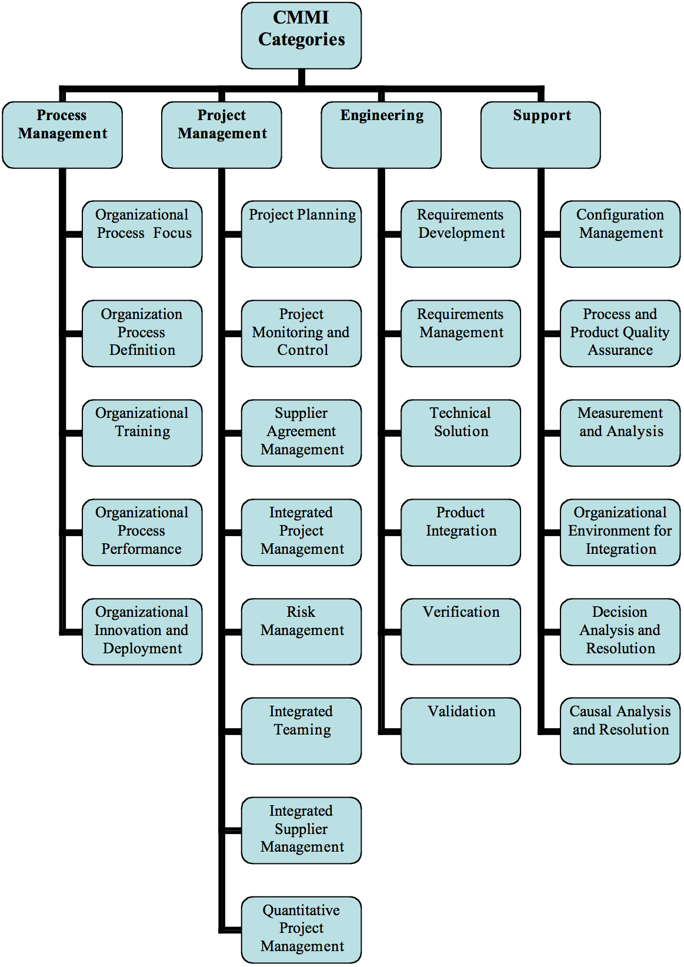
CMMI

Slide 15
Integrated
CMM
iCMM is widely used in the Federal Aviation Administration (FAA-iCMM)
  Provides a single model for enterprise-wide improvement
  integrates the following standards and models:
    ISO 9001:2000, EIA/IS 731,
    Malcolm Baldrige National Quality Award and President's Quality Award criteria,
    CMMI-SE/SW/IPPD and
    CMMI-A, ISO/IEC TR 15504, ISO/IEC 12207, and ISO/IEC CD 15288.

Slide 16
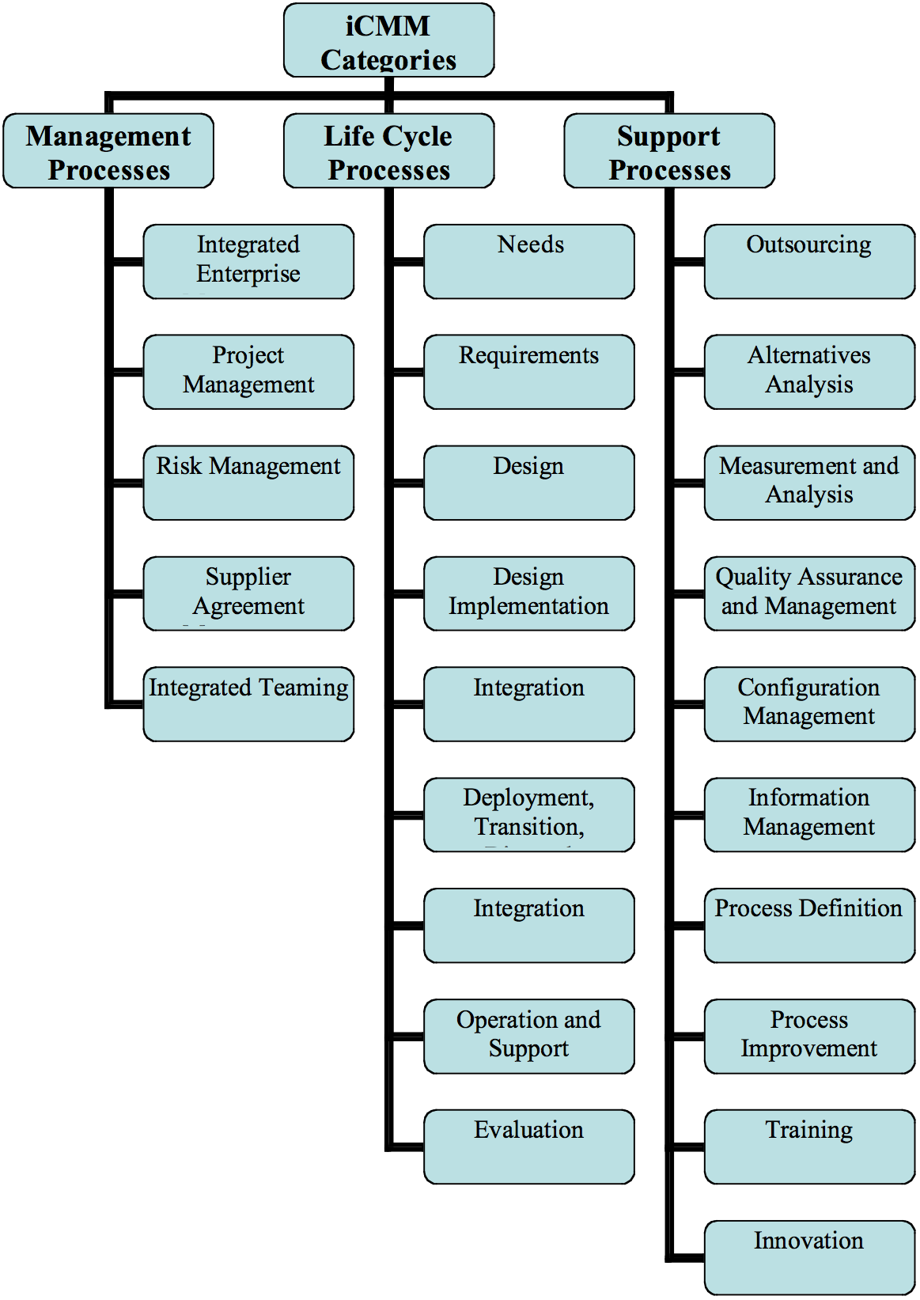
Integrated
CMM

Slide 17
Trusted
CMM
Trusted CMM
  Early 1990 -Trusted Software Methodology (TSM)
  TSM defines trust levels
    Low emphasizes resistance to unintentional vulnerabilities
    High adding processes to counter malicious developers
  TSM was later harmonized with CMM
    Not much in use

Slide 18
Systems Security
Engineering CMM
The SSE-CMM
    To improve and assess the security engineering capability of an organization
  provides a comprehensive framework for
    evaluating security engineering practices against the generally accepted security engineering principles.
  provides a way to
    measure and improve performance in the application of security engineering principles.

Slide 19
SSE-CMM
Purpose for SSE-CMM
  To fill the lack of a comprehensive framework for evaluating security engineering practices against the principles
The SSE-CMM also
  describes the essential characteristics of an organization’s security engineering processes.
    The SSE-CMM is now ISO/IEC 21827 standard (version 3 is available)

Slide 20
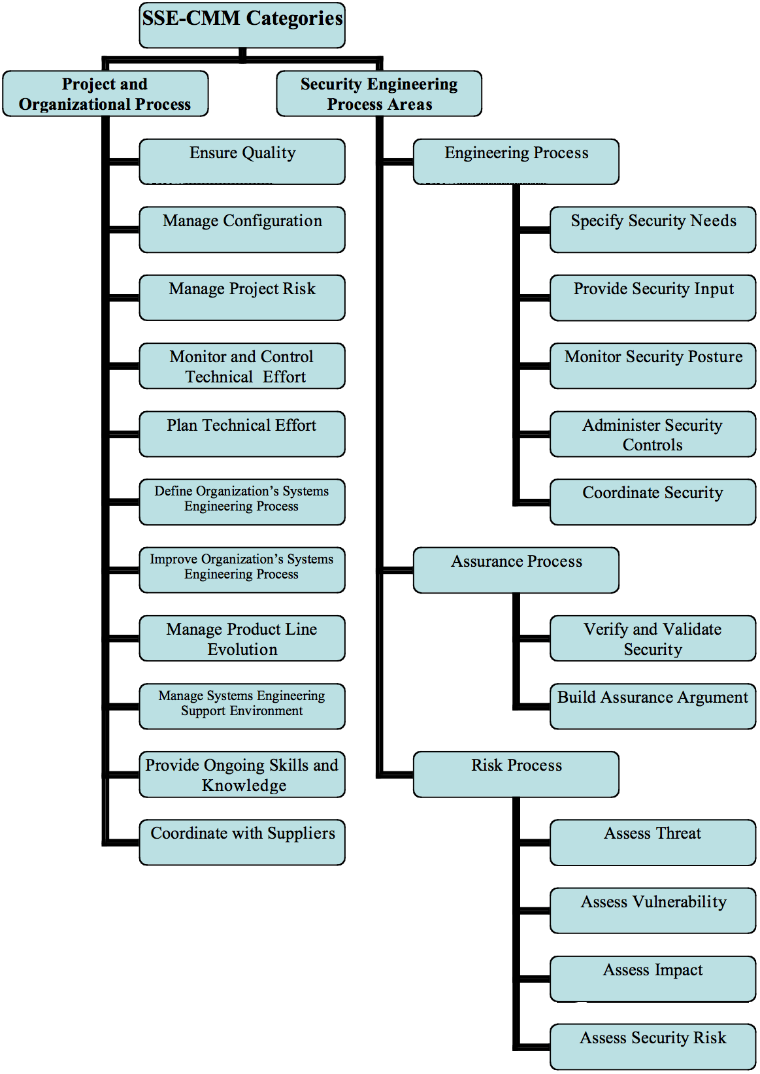

Slide 21
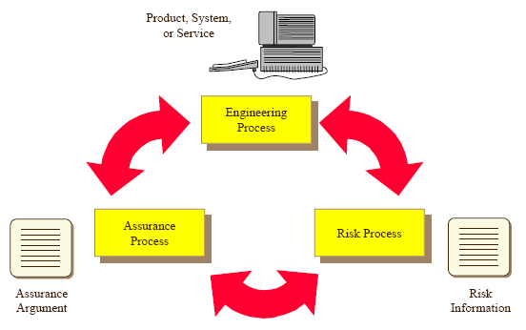
Security Engineering Process

Slide 22
Security Risk Process

Slide 23
Security is part of Engineering

Slide 24
Assurance

Slide 25
SSE-CMM Dimensions
Practices (generic) that indicate
Process Management &
Institutionalization Capability
All the base practices

Slide 26
SSE-CMM
129 base practices Organized into 22 process areas
    61 of these, organized in 11 process areas, cover all major areas of security engineering
    Remaining relates to project and organization domains
Base practice
    Applies across the life cycle of the enterprise
    Does not overlap with other base practices
    Represents a “best practice” of the security community
    Does not simply reflect a state of the art technique
    Is applicable using multiple methods in multiple business context
    Does not specify a particular method or tool

Slide 27
Process Area
Assembles related activities in one area for ease of use
Relates to valuable security engineering services
Applies across the life cycle of the enterprise
Can be implemented in multiple organization and product contexts
Can be improved as a distinct process
Can be improved by a group with similar interests in the process
Includes all base practices that are required to meet the goals of the process area

Slide 28
Process Areas
Process Areas related to Security
Engineering process areas
Process Areas related to project and
Organizational practices

Slide 29
Generic Process Areas
Activities that apply to all processes
They are used during
  Measurement and institutionalization
Capability levels
  Organize common features
  Ordered according to maturity

Slide 30
Capability Levels
0
Not
Performed
1
Performed
Informally
2
Planned &
Tracked
3
Well
Defined
4
Quantitatively
Controlled
5
Continuously
improving
Committing to perform
Planning performance
Disciplined performance
Tracking performance
Verifying performance
Defining a standard process
Tailoring standard process
Using data
Perform a defined process
Establishing measurable quality goals
Determining process capability to achieve goals
Objectively managing performance
Establishing quantitative process goals
Improving process effectiveness
Base Practices
Performed

Slide 31
Summary Chart.

Slide 32
Using SSE-CMM
Can be used in one of the three ways
  Process improvement
    Facilitates understanding of the level of security engineering process capability
  Capability evaluation
    Allows a consumer organization to understand the security engineering process capability of a provider
  Assurance
    Increases the confidence that product/system/service is trustworthy

Slide 33
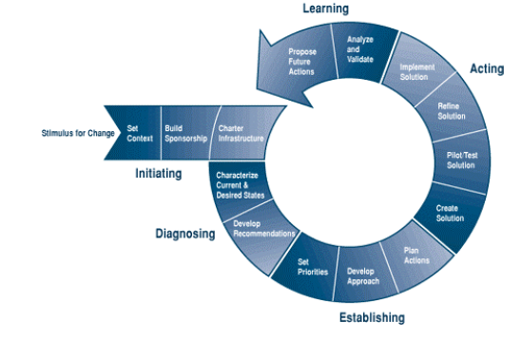
Process Improvement

Slide 34
Capability Evaluation
No need to use any particular appraisal method
SSE-CMM Appraisal (SSAM) method has been developed if needed
SSAM purpose
  Obtain the baseline or benchmark of actual practice related to security engineering within the organization or project
  Create or support momentum for improvement within multiple levels of the organizational structure

Slide 35
SSAM Overview
Planning phase
  Establish appraisal framework
Preparation phase
  Prepare team for onsite phase through information gathering (questionnaire)
  Preliminary data analysis indicate what to look for / ask for
Onsite phase
  Data gathering and validation with the practitioner
  interviews
Post-appraisal
  Present final data analysis to the sponsor

Slide 36
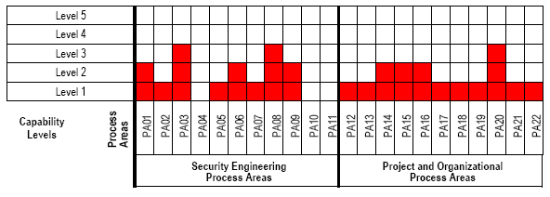
Capability Evaluation

Slide 37
Assurance
A mature organization
  more likely to create a product or system with appropriate assurance
Process evidence
  to support claims for the product trustworthiness
It is conceivable that
  An immature organization could produce high assurance product.

Slide 38
CMI/iCMM/SSE-CMM
CMMI / iCMM used by more organizations than the SSE-CMM
  Because of the integration of process disciplines and coverage of enterprise issues,
One weakness CMMI and iCMM
  have gaps in their coverage of safety and security.
Joint effort sponsored by FAA and the DoD
  to identify best safety and security practices for use in combination with the iCMM and the CMMI.

Slide 39
Safety/Security additions
The proposed Safety and Security additions include the following four goals:
  Goal 1 – An infrastructure for safety and security is established and maintained.
  Goal 2 – Safety and security risks are identified and managed.
  Goal 3 – Safety and security requirements are satisfied.
  Goal 4 – Activities and products are managed to achieve safety and security requirements and objectives.

Slide 40
Goal 1 related practices
  Ensure safety and security awareness, guidance, and competency.
  Establish and maintain a qualified work environment that meets safety and security needs.
  Ensure integrity of information by providing for its storage and protection, and controlling access and distribution of information.
  Monitor, report and analyze safety and security incidents and identify potential corrective actions.
  Plan and provide for continuity of activities with contingencies for threats and hazards to operations and the infrastructure
  Goal 1 – An infrastructure for safety and security is established and maintained.

Slide 41
Goal 2 related practices
Identify risks and sources of risks attributable to vulnerabilities, security threats, and safety hazards.
For each risk associated with safety or security, determine the causal factors, estimate the consequence and likelihood of an occurrence, and determine relative priority.
For each risk associated with safety or security, determine, implement and monitor the risk mitigation plan to achieve an acceptable level of risk.
  Goal 2 – Safety and security risks are identified and managed.

Slide 42
Goal 3 related practices
Identify and document applicable regulatory requirements, laws, standards, policies, and acceptable levels of safety and security.
Establish and maintain safety and security requirements, including integrity levels, and design the product or service to meet them.
Objectively verify and validate work products and delivered products and services to assure safety and security requirements have been achieved and fulfill intended use.
Establish and maintain safety and security assurance arguments and supporting evidence throughout the lifecycle.
  Goal 3 – Safety and security requirements are satisfied.

Slide 43
Goal 4 related practices
Establish and maintain independent reporting of safety and security status and issues.
Establish and maintain a plan to achieve safety and security requirements and objectives.
Select and manage products and suppliers using safety and security criteria.
Measure, monitor and review safety and security activities against plans, control products, take corrective action, and improve processes.
  Goal 4 – Activities and products are managed to achieve safety and security requirements and objectives.

Slide 44
Team Software Process for Secure SW/Dev
TSP
  provides a framework, a set of processes, and disciplined methods for applying software engineering principles at the team and individual level
TSP for Secure Software Development (TSP-Secure)
  focus more directly on the security of software applications.

Slide 45
Team Software Process for Secure SW/Dev
TSP-Secure addresses secure software development (three ways).
  Secure software is not built by accident,
    Plan: TSP-Secure addresses planning for security.
    Self-direct: Since schedule pressures and people issues get in the way of implementing best practices, TSP-Secure helps to build self-directed development teams, and then put these teams in charge of their own work.

Slide 46
TSP-Secure
  Since security and quality are closely related,
    TSP-Secure helps manage quality throughout the product development life cycle.
  Since people building secure software must have an awareness of software security issues,
    TSP-Secure includes security awareness training for developers.

Slide 47
TSP-Secure
Teams
  Develop their own plans
  Make their own commitments
  Track and manage their own work
  Take corrective action when needed

Slide 48
TSP-Secure
Initial planning – “project launch” (3-4 days)
  Tasks include
    identifying security risks,
    eliciting and defining security requirement, secure design, and code reviews,
    use of static analysis tools, unit tests, and Fuzz testing.
Next, the team executes its plan, and ensures all security related activities are taking place.
  Security status is presented and discussed during every management status briefing.

Slide 49
TSP-Secure
Basis
  Defective software is seldom secure
  Defective software is not inevitable
    Consider cost of reducing defects
    Manage defects throughout the lifecycle
  Defects are leading cause of vulnerabilities
    Use multiple defect removal points in the SD
      Defect filters

Slide 50
TSP-Secure
Key questions in managing defects
  What type of defects lead to security vulnerabilities?
  Where in the software development life cycle should defects be measured?
  What work products should be examined for defects?
  What tools and methods should be used to measure the defects?
  How many defects can be removed at each step?
  How many estimated defects remain after each removal step?
TSP-Secure includes training for developers, managers, and other team members.

Slide 51
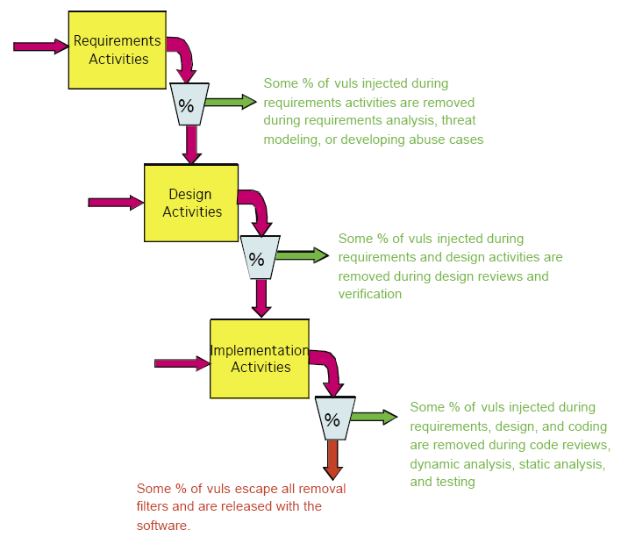

Slide 52
Correctness by Construction
CbC Methodology from Praxis Critical Systems
  Process for developing high integrity software
  Has been successfully used to develop safety-critical systems
  Removes defects at the earliest stages
  uses formal methods to specify behavioral, security and safety properties of the software.

Slide 53
Correctness by Construction
The seven key principles of Correctness-by-Construction are:
  Expect requirements to change
  Know why you're testing (debug + verification)
  Eliminate errors before testing
  Write software that is easy to verify
  Develop incrementally
  Some aspects of software development are just plain hard
  Software is not useful by itself

Slide 54
Correctness by Construction
Correctness-by-Construction is
  one of the few secure SDLC processes that incorporate formal methods into many development activities.
  Requirements are specified using Z, and verified.
  Code (in Spark) is checked by verification software.

Slide 56
Correctness by Construction
Defect detection/Correction

Slide 57
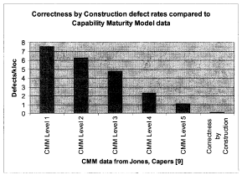
Effort and Defect Rate

Slide 58
Agile Methods
Agile manifesto
  “We are uncovering better ways of developing software by doing it and helping others do it. Through this work we have come to value:
    Individuals and interactions over processes and tools
    Working software over comprehensive documentation
    Customer collaboration over contract negotiation
    Responding to change over following a plan

Slide 59
Agile manifesto principles
Our highest priority is to satisfy the customer through early and continuous delivery of valuable software.
Welcome changing requirements, even late in development. Agile processes harness change for the customer's competitive advantage.
Deliver working software frequently, from a couple of weeks to a couple of months, with a preference to the shorter timescale.
Business people and developers work together daily throughout the project.
Build projects around motivated individuals. Give them the environment and support they need, and trust them to get the job done.
The most efficient and effective method of conveying information to and within a development team is face-to-face conversation.
Working software is the primary measure of progress.
Agile processes promote sustainable development. The sponsors, developers and users should be able to maintain a constant pace indefinitely.
Continuous attention to technical excellence and good design enhances agility.
Simplicity—the art of maximizing the amount of work not done—is essential.
The best architectures, requirements and designs emerge from self-organizing teams.
At regular intervals, the team reflects on how to become more effective, then tunes and adjusts its behavior accordingly.

Slide 60
Agile Processes
Among many variations
  Adaptive software development (ASP)
  Extreme programming (XP)
  Crystal
  Rational Unified Process (RUP)

Slide 61
TSP Revisited
- How TSP Relates to Agile ..
Individuals and interactions over processes and tools
TSP holds that the individual is key to product quality and effective member interactions are necessary to the team's success.
  Project launches strive to create gelled teams.
  Weekly meetings and communication are essential to sustain them.
  Teams define their own processes in the launch.

Slide 62
How TSP Relates
Working software over comprehensive documentation
TSP teams can choose evolutionary or iterative lifecycle models to deliver early functionality—the focus is on high quality from the start. TSP does not require heavy documentation.
  Documentation should merely be sufficient to facilitate effective reviews and information sharing.

Slide 63
How TSP Relates
Customer collaboration over contract negotiation
Learning what the customer wants is a key focus of the “launch”. Sustaining customer contact is one reason for having a customer interface manager on the team.
  Focus on negotiation of a contract is more a factor of the organization than of whether TSP is used.

Slide 64
How TSP Relates
Responding to change over following a plan
TSP teams expect and plan for change by:
  Adjusting the team's process through process improvement proposals and weekly meetings.
  Periodically re-launching and re-planning whenever the plan is no longer a useful guide.
  Adding new tasks as they are discovered; removing tasks that are no longer needed.
  Dynamically rebalancing the team workload as required to finish faster.
  Actively identifying and managing risks.

Slide 66
Besnosov Comparison
50% of traditional security assurance activities are not compatible with Agile methods (12 out of 26),
less than 10% are natural fits (2 out of 26),
about 30% are independent of development method, and
slightly more than 10% (4 out of 26) could be semi-automated and thus integrated more easily into the Agile methods.

Slide 67
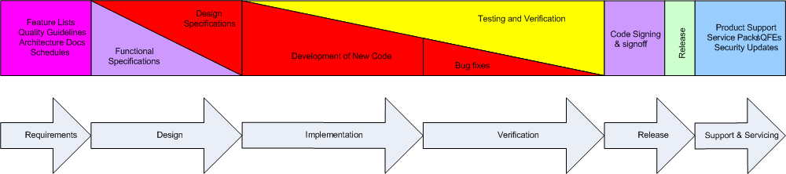
Microsoft Trustworthy Computing SDLC
Generally accepted SDL process at MS
(actually spiral not “waterfall” as it indicates)

Slide 68
SDL Overview
MS’s SD³ + C paradigm
  Secure by Design
  Secure by Default
  Secure by Deployment
  Communications
    software developers should be prepared for the discovery of product vulnerabilities and should communicate openly and responsibly
  The SDL is updated as shown next

Slide 69
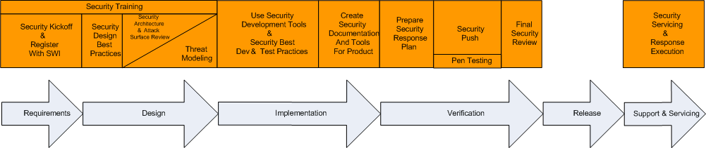
SDL at MS
Add the SD³ + C praradigm

Slide 70
Design Phase
Define Security architecture and design guidelines
  Identify tcb; use layering etc.
Document the elements of the software attack surface
  Find out default security
Conduct threat modeling
Define supplemental ship criteria

Slide 71
Implementation phase
Apply coding and testing standards
Apply security testing tools including fuzzing tools
Apply static analysis code scanning tools
Conduct code reviews

Slide 72
Verification Phase
“Security push” for Windows server 2003
  Includes code review beyond those in implementation phase and
  Focused testing
Two reasons for “security push”
  Products had reached the verification phase
  Opportunity to review both code that was developed or updated during the implementation phase and “legacy code” that was not modified

Slide 73
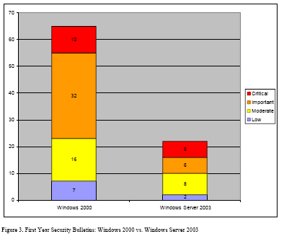
Results

Slide 74
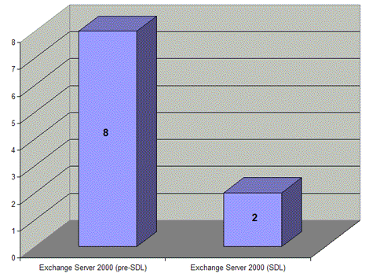
Results

Slide 75
Topic to be continued …

